Slide 1

EDFLIX
Adalarasu, Ananyaa
Chen, Juntao
Huang, Lucas Jiaye
Lin, Qitao
Tisdall, Niamh
Zhou, Stan Ziyao

Slide 2
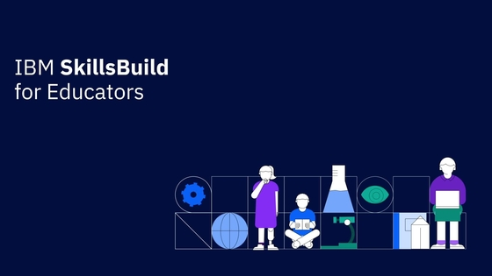

Our Client

Slide 3
Aims
Front end video streaming style wrapper
AI supported recommendation system
Comments and rating systems

Slide 4
Deliverables
Web based user interface
SQL Database storing user and usage data
Visualization of collected data
IBM Watson AI
GitHub storing all code and data accessible by development team,
Durham University, and IBM

Slide 5
Introduction
Our client, Aims, Deliverables
Project Development
Software development framework
01
03
Technical Outline
Communication between systems,
Data flow, Front end, Back end,
Potential features
Future Plan
Weekly plan, Tasks for sub teams,
Work before and after test plan
04
02

Slide 6
Technical Outline
A detailed design of the software

Slide 7
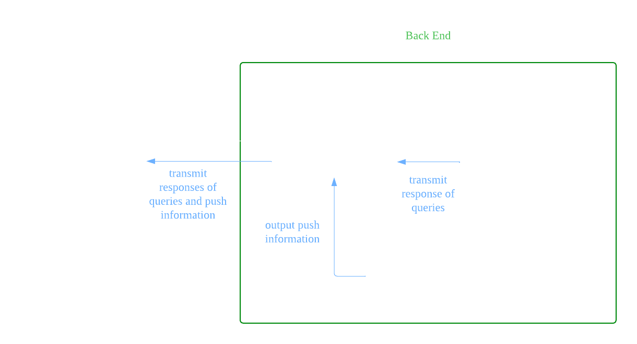
Communication between Systems

Slide 8
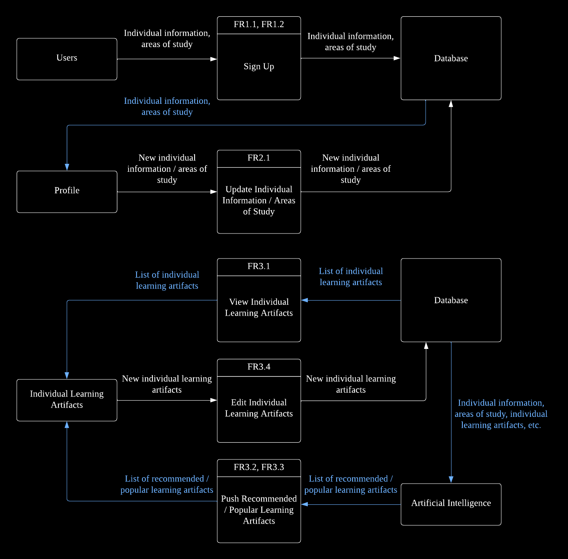
Data Flow

Slide 9
Data Flow

Slide 10
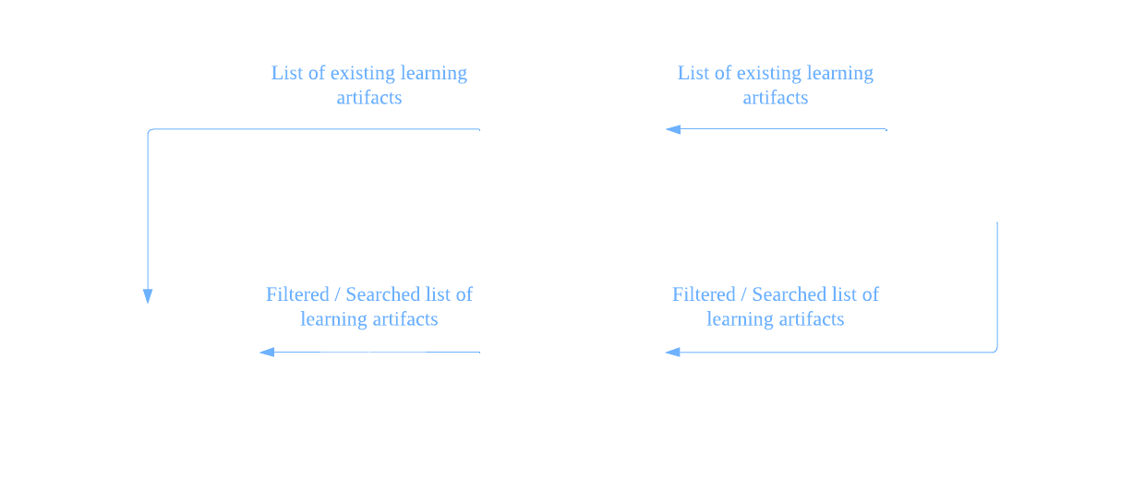
Data Flow

Slide 11
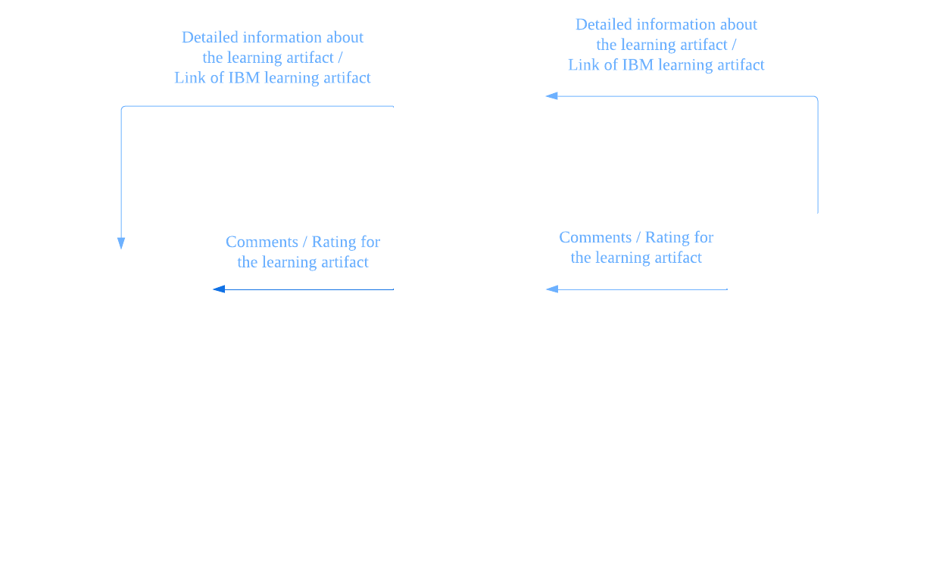
Data Flow

Slide 12
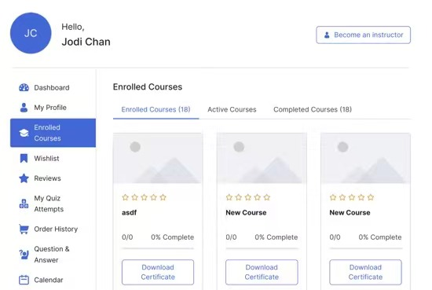
Front End

Slide 13
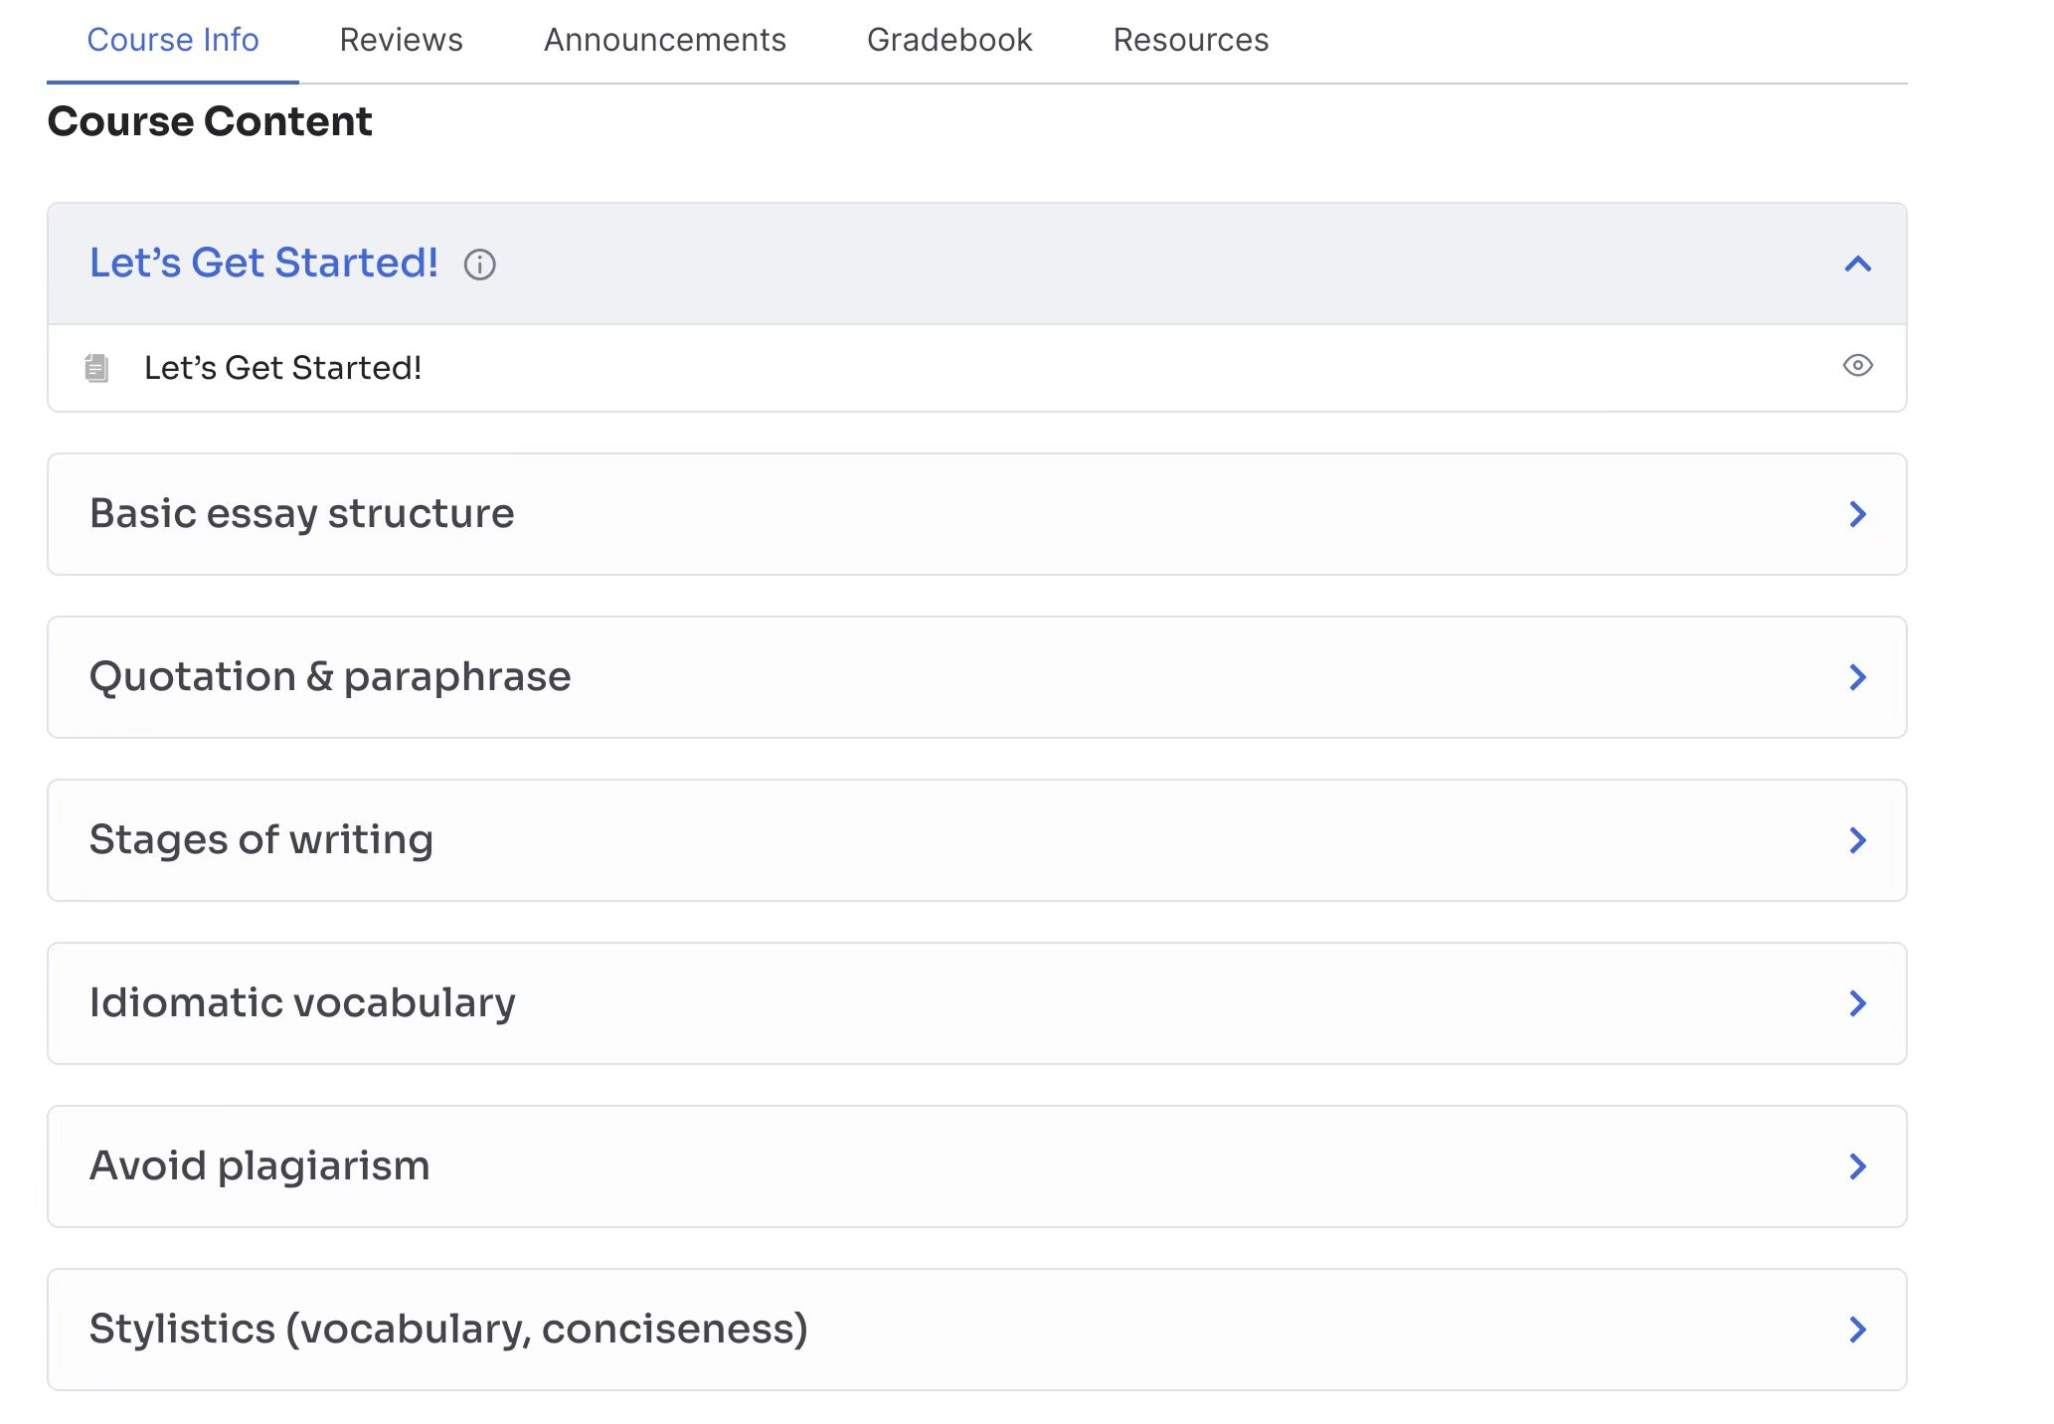
Front End

Slide 14
Back End – RESTful API
Standard HTTP Method | ID | Functional Requirements
GET | FR3.1 | View individual learning artifacts
 | FR3.2, FR3.2 | Push recommended / popular learning artifacts
 | FR4.1 | View existing learning artifacts
 | FR4.2, FR4.3 | Filter / Search learning artifact(s)
 | FR5.1 | View information about the learning artifact
 | FR5.2, FR5.3 | View comment / rating for the learning artifact
 | FR5.4 | Link to IBM learning artifact
POST | FR1.1, FR1,2 | Sign up
 | FR5.2 | Create comment for the learning artifact
PATCH | FR2.1 | Update individual information / area(s) of study
 | FR3.4 | Edit individual learning artifacts
 | FR5.3 | Add rating for the learning artifact
DELETE | FR2.3 | Delete account

Slide 15
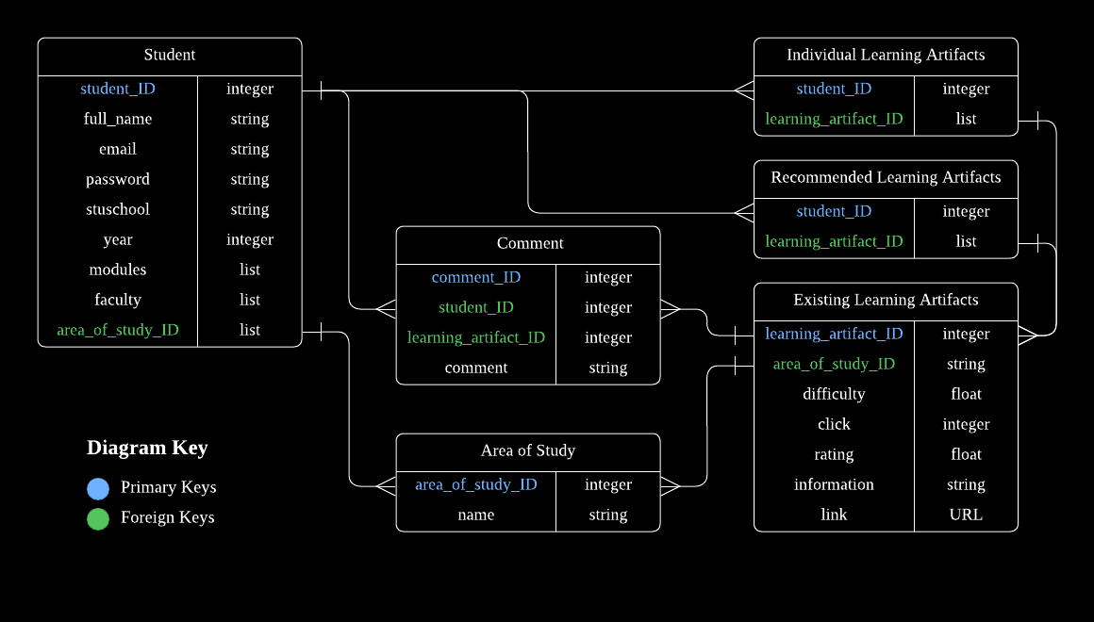
Back End – Database

Slide 16
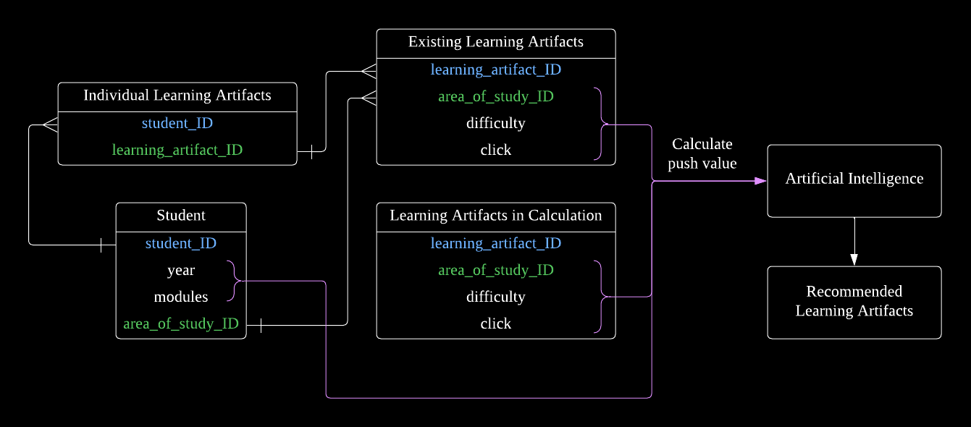
Back End – AI

Slide 17
Potential Features
HTTP cookies
save essential user information for future use
AI
high-dimensional portrait of the user
Database
automatic addition and deletion of the learning artifacts and their corresponding resources
web crawling and advanced database querying

Slide 18

Project Development
Chosen process for the software development

Slide 19
Software Development Process
Dynamic System Development Method (DSDM)
Pre-planned time boxes
Intermediary meeting
Functionality check against requirements
Review of work
Notes:
We’ve decided to use DSDM as our software development framework as we found it best fit our goals and patterns of work. This involves working in pre-planned time boxes, each lasting two weeks, beginning with a team meeting to discuss and assign tasks for each time box. An intermediary meeting within the two weeks is scheduled to allow us to check in with other group members, and offer support if anyone feels unable to get the work done in time. After this mid-point, functionality which can be tested should be checked against requirements in time for the group meeting at the end of the timebox, used to review the past two weeks of work and schedule tasks for the next timebox.

Slide 20
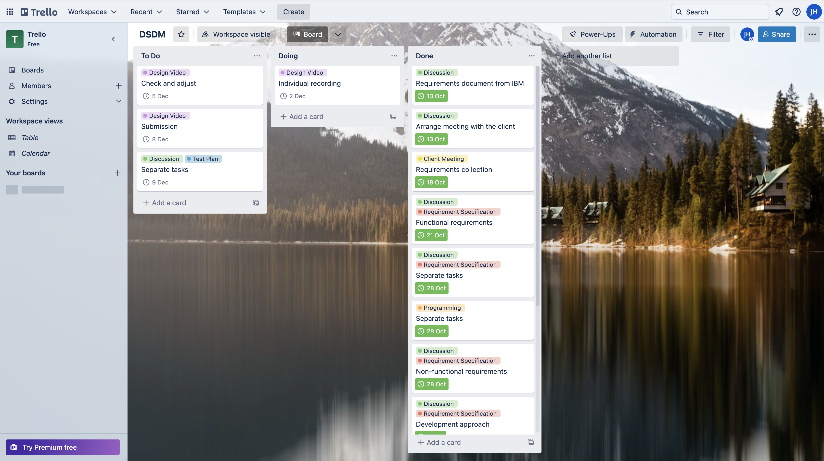
Trello
Notes:
In order to keep track of various tasks given to group members we have decided to use Trello, which allows users to create lists of tasks, move items across lists, and assign priorities as well as due dates. We will update our Trello with tasks after our weekly meetings as well as individually when tasks get completed. This allows all members of the group to be fully aware of where we are in our project timeline.

Slide 21
Future Plan
Tasks to do next, before and after the test plan

Slide 22
Future Plan
Weekly
Meeting
Progress report from each group member
Client updates
Software
Front end, database, AI
Document
Content of test plan
Notes:
As mentioned previously we will meet on a weekly basis to listen to a progress report from each group member, and monitor every possible risk or issue that may damage the entire development process. During these meetings we will also draft any questions, concerns, or updates we have for our client, which can then be discussed by email or a short separate online meeting with only the relevant group members
Meanwhile, the programming sub team will continue working on the development of the front end, database, and the AI. The development of the RESTful API will begin after the first release of these three phases.
The documentation sub team will start to discuss the contents of the test plan based on the progress of the programming sub team.

Slide 23
Future Plan
Before submission of test plan
First release of the software
High priority functionalities
After submission of test plan
More release of the software
Medium and low priority functionalities
Potential features
Functional and non-functional standard test and adjust
Product handover
Notes:
Before the submission of the test plan, we aim to complete the first release of our software. This release should contain all core functionalities which are high priorities in the requirement specification. Among them, the AI should be implemented to work properly and intelligently. The RESTful API should link all phases in the front end and the back end successfully.
After the submission of the test plan, more releases of the software will be developed based on functionalities with a medium or low priority, and the potential features mentioned previously. Eventually, the software will be tested and adjusted to satisfy all non-functional requirements as much as possible before the product handover.

Slide 24
Thank you
Notes:
We hope this video gives you a clearer understanding of how we plan to tackle the EDFlix brief. Thank you for listening.

